Slide 1

AI & ML Virtual Internship
by
LIKHITHA SRI P
Roll No. 204G1A3227
Department of Computer Science and Engineering (Data Science)
Srinivasa Ramanujan Institute of Technology
Autonomous
Rotarypuram Village, B K Samudram Mandal, Ananthapuramu – 515701.
2023-2024

Slide 2

Contents
Introduction
Modules
Modules Explanation
Conclusion
References

Slide 3
Introduction
AWS Academy Cloud Foundations
Provides a brief over view of principles of Cloud, AWS well architecture format.
AWS Academy Machine Learning Foundation
Offers a hands-on experience in evaluating the data, training the models.
Presents a scenario how to create a custom datasets for the Computer Vision.
All India Council for Technical Education (AICTE) has initiated various activities for promoting industrial internship.
Eduskills is a Non-profit organization which enables Industry 4.0 ready digital workforce in India.
With a vision to create an industry-ready work force, Eduskills & AICTE launches ‘Virtual Internship’ program on Cloud Technology, supported by Amazon Web Services(AWS).

Slide 4
Modules
Cloud Concepts Overview
Cloud Economics and Billing
AWS Cloud Security
Networking and Content Delivery
Storage
Cloud Architecture
Introduction to Machine Learning
Introducing Forecasting
Introducing Computer Vision (CV)
Introducing Natural Language Processing

Slide 5
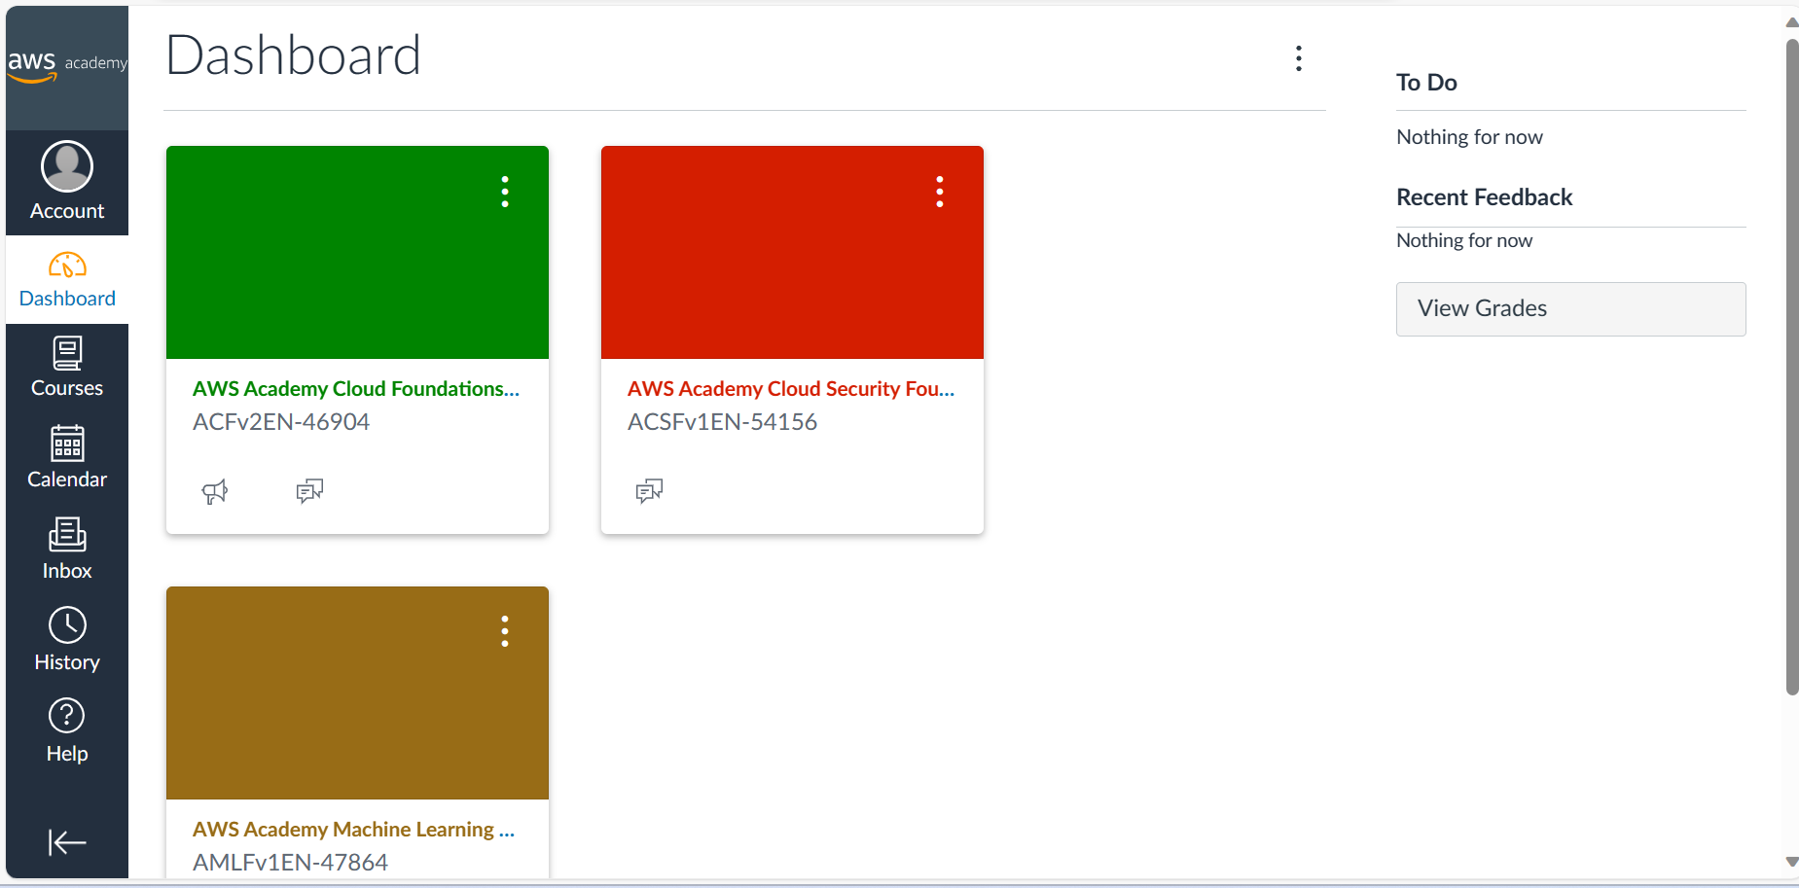
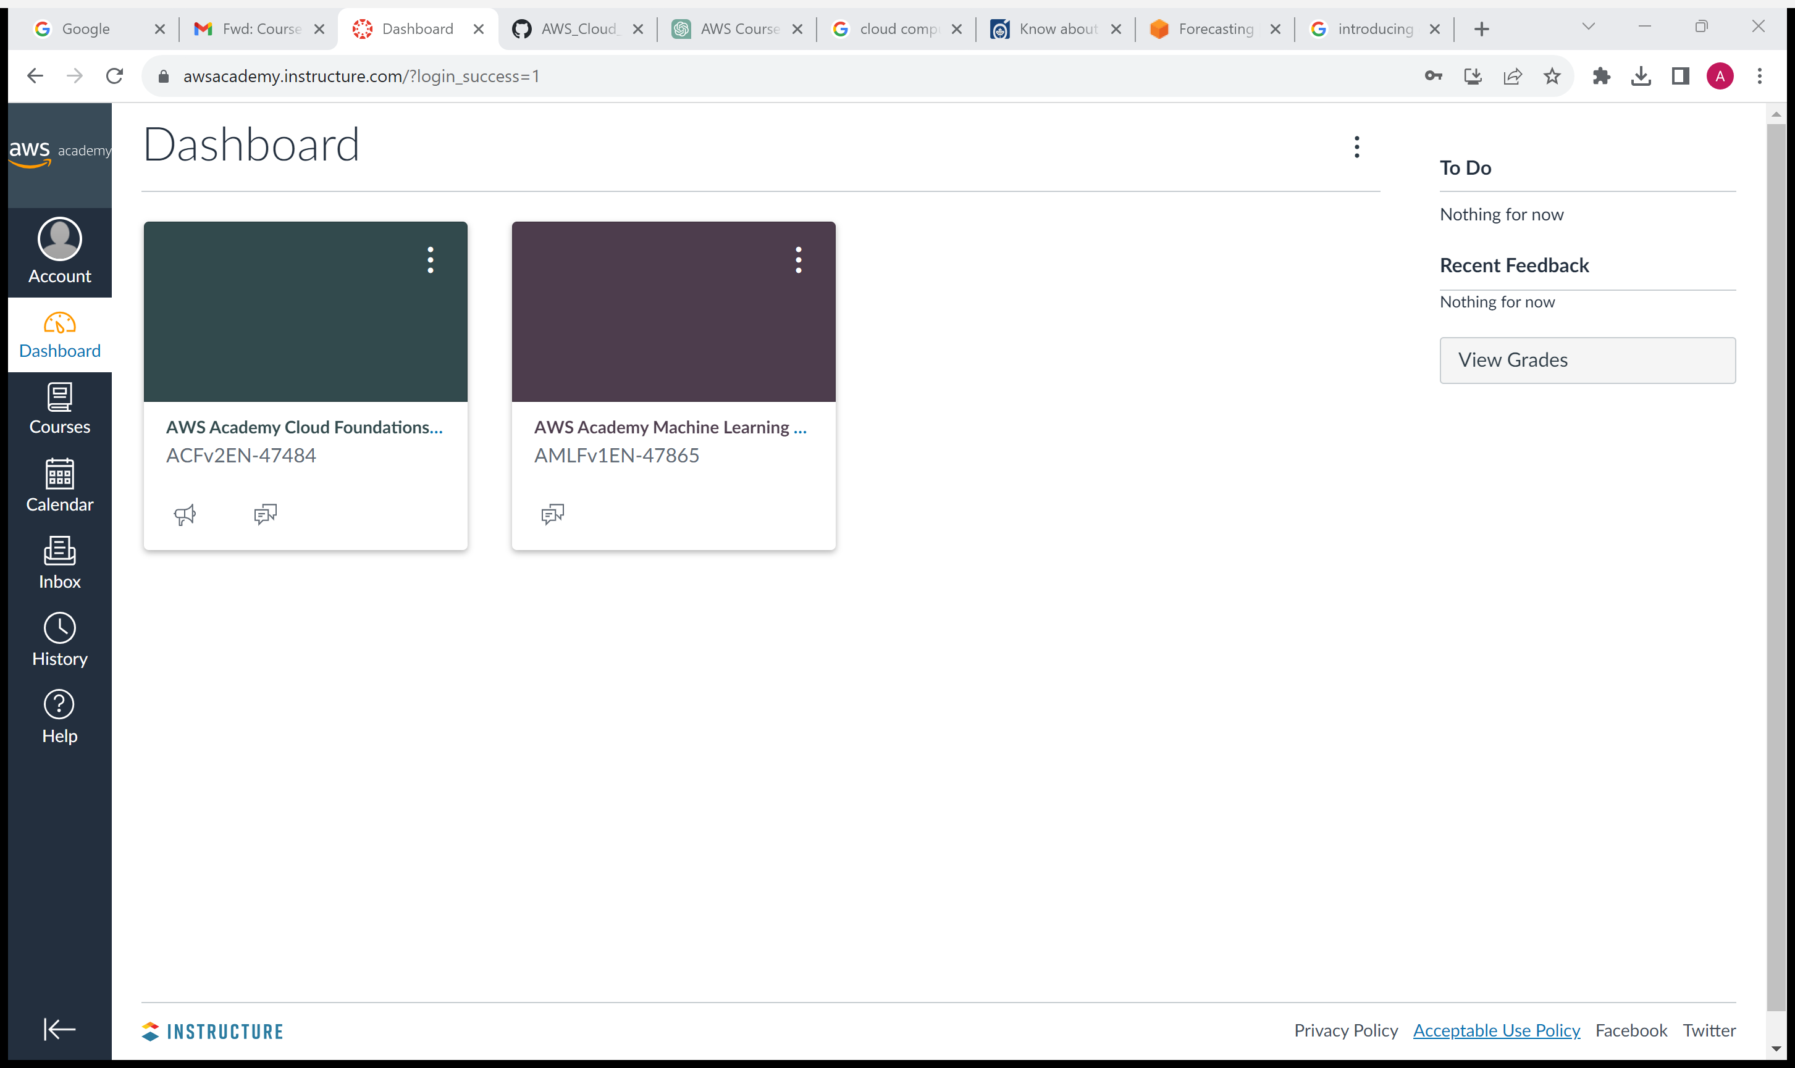
Dashboard

Slide 6
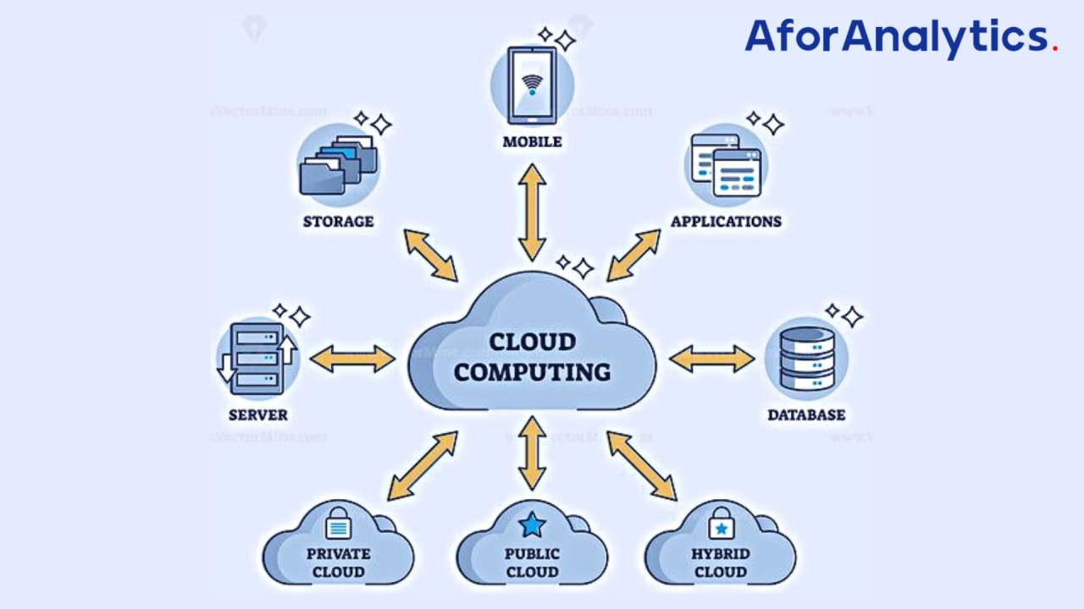
Cloud Concepts Overview
Cloud Computing: The on-demand delivery of compute power, database, storage, applications, and other IT resources via the internet with pay-as-you-go pricing. Cloud computing enables you to stop thinking of infrastructure as hardware, and instead think of (and use) it as software.
Cloud service models
Infrastructure as a Service (IaaS)
Platform as a Service (PaaS)
Software as a Service (SaaS)

Slide 7
Cloud Economics and Billing
Three Fundamental Cost Drivers with AWS
Compute - charged by use time, varies by instance
Storage - charged per GB
Data Transfer - outbound transfers are aggregated and charged per GB
Billing
AWS Organizations: An account management service that enables you to consolidate multiple AWS accounts into an organization that you create and centrally manage.
Key Features and Benefits
Policy based account management
Group based account management
Consolidated billing

Slide 8
AWS Cloud Security
Customer Security
Applications - Passwords, role-based access, etc.
Security group configuration.
OS or host-based firewalls - Including intrusion detection or prevention systems.
Network configurations
AWS Security
Physical security of data centers - Controlled, need-based access
Network infrastructure
Virtualization infrastructure - Instance isolation
Securing a New AWS Account
Stop using the account root user as soon as possible
Enable multi-factor authentication (MFA)
Use AWS Cloud Trail

Slide 9
Networking and Content Delivery
Networking Basics
Network: Two or more machines that are connected together in order to communicate.
IP Address: A unique numerical label assigned to each device connected to a computer network.
Classless Inter-Domain Routing (CIDR): A method for allocating IP addresses and IP routing.
Amazon VPC
Enables you to customize the network configuration for your VPC.
Enables you to use multiple layers of security.
You can create a VPC that spans multiple Availability Zones.

Slide 10
Storage
Amazon Elastic Block Store (EBS)
Amazon Elastic Block Store (EBS) is an easy to use, high performance block storage service designed for use with Amazon Elastic Compute Cloud (EC2) for both throughput and transaction intensive workloads at any scale.
Amazon Simple Storage Service (S3)
Data is stored as objects in buckets.
Virtually unlimited storage but a single object is limited to 5 TB .
Granular access to bucket and objects

Slide 11
Cloud Architecture
AWS Well-Architecture Framework
A consistent approach to evaluating and implementing cloud architectures.
A way to provide best practices that were developed through lessons learned by reviewing
customer architectures.
The AWS Well-Architected Tool helps you to implement the Well-Architected Framework.
Reliability
A measure of your system’s ability to provide functionality when desired by the user.

Slide 12
Introduction to Machine Learning
Machine learning is a subset of a broader computer science field that is known as artificial intelligence (AI).
Deep learning represents a significant leap forward in the capabilities for AI and ML. The theory behind deep learning was created from how the human brain works.
Machine Learning tools Overview
Jupyter Notebook is an open-source web application that enables you to create and share
documents that contain live code, equation, visualizations, and narrative text.
JupyterLab is a web-based interactive development environment for jupyter notebooks, code,
and data. JupyterLab is flexible.
Pandas is an open-source Python library. It’s used for data handling and analysis. It represents
data in a table that is similar to a spreadsheet.

Slide 13
Introduction Forecasting
Machine Learning Forecasting is a process that uses algorithms to learn from data and make predictions about future events.
There are 2 types of Forecasting Methods:
Qualitative Method
Example is Market Research Techniques like polls and surveys.
Quantitative Method
Forecasting to improve the accuracy of forecasts while minimizing a loss function.
Forecasting Solutions offer planning for common use cases in Retail, Supply Chain, resource and operational planning to predict future time-series data based on historical data and require no machine learning experience.

Slide 14
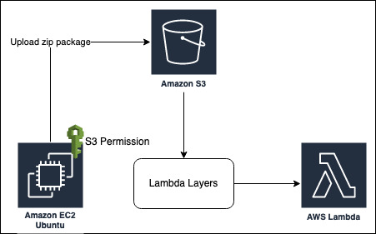
Introducing Computer Vision (CV)
Introduction to Computer Vision:
Computer vision is an interdisciplinary field that bridges the gap between computers and
visual information.
Fig: OpenCV with AWS Lambda via Layers.

Slide 15
Introducing Computer Vision (CV)
Visual Data Interpretation:
Computer vision systems use a combination of mathematics, algorithms, and machine
learning techniques to analyze and extract meaningful insights from visual data.
Challenges and Advances:
Despite its impressive capabilities, computer vision faces challenges such as handling
diverse lighting conditions, complex scenes, and occlusions.
Analyzing images and videos
This process involves utilizing computer vision techniques to extract valuable information
from visual data.

Slide 16
Introducing Natural Language Processing
NLP stands for Natural Language Processing, which is a part of Computer Science, Human language, and Artificial Intelligence. It is the technology that is used by machines to understand, analyse, manipulate, and interpret human's languages.
Amazon Polly is a managed service that converts text into lifelike speech. It supports multiple languages and includes various lifelike voices.
Amazon Polly uses deep learning technologies to synthesize natural-sounding human speech, so you can convert articles to speech. With dozens of lifelike voices across a broad set of languages, use Amazon Polly to build speech-activated applications.

Slide 17
Conclusion
AWS course provides a comprehensive and invaluable journey into the real of Amazon Web Services, equipping participants with the essential knowledge and practical skills required to harness the power of cloud computing.
With the ability to leverage AWS's scalability, security, and innovation, course graduates are well-positioned to contribute to their organizations' success, drive digital transformation.
Seize the boundless opportunities presented by cloud computing in the modern technological landscape.

Slide 18
References
[1] http://awsacademy.instructor.com
[2] https://internship.aicte-india.org

Slide 19
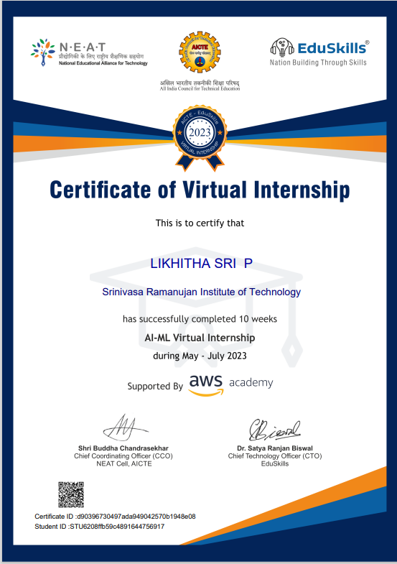
Internship Certificate

Slide 20
Thank You!!!

